Slide 1
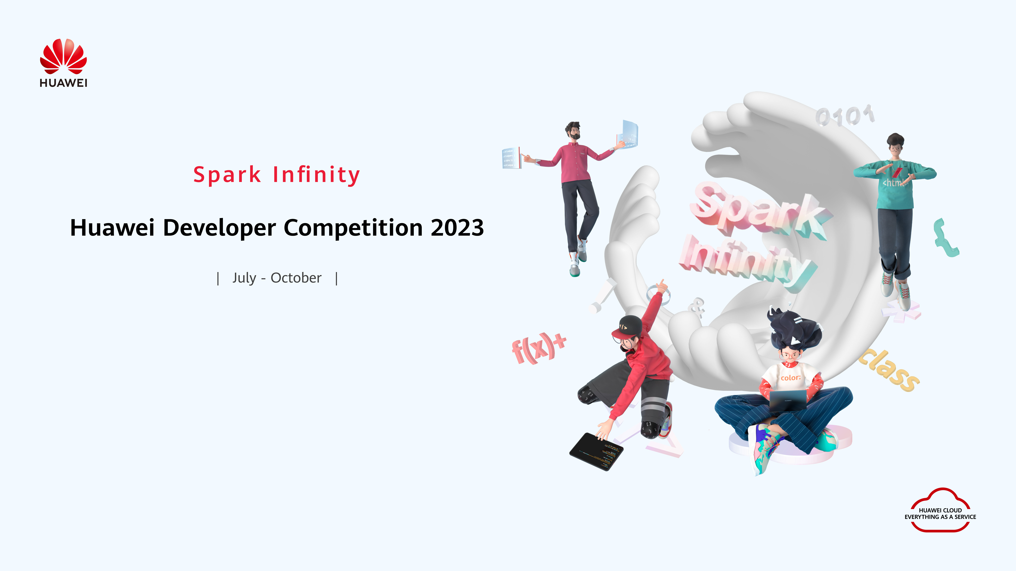




REPACKAGING
FEATURE
Challenge Name: Carbon Emission Control
Project Name: Carbon Offset Credit Centralised Optimising System with Machine Learning Approaches
Team Name: RepackagingFeature
Organization: Universiti Tunku Abdul Rahman
Email/Phone: 2000tanjingjie@gmail.com

Slide 2
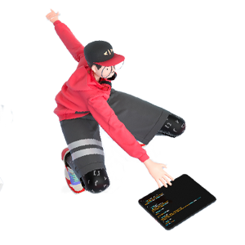

Project Overview
REPACKAGING
FEATURE
Overview
Project Name | COCCOS - Carbon Offset Credit Centralised Optimising System with Machine Learning Approaches
Team Name | RepackagingFeature
Contacts | 2000tanjingjie@gmail.com, +601138100852 (h/p: Tan Jing Jie)
Technical Field | Carbon Emission Management, Machine Learning
Technologies | Cloud Services, Machine Learning, Big Data Analytics
Keywords | Carbon Emissions, Offset Credits, Machine Learning, Cloud-based, Analytics
Applicable Fields | Environment, Sustainability, Industries with Carbon Footprint
Description (in 500 words) | Introducing COCCOS: Revolutionizing Carbon Emission Control through Cloud-Native Innovation COCCOS presents a groundbreaking approach to carbon emission control, transcending the limitations of static models. Existing carbon offset credit strategies lack the adaptability needed to navigate evolving environmental conditions and regulatory frameworks. COCCOS leverages cloud-native capabilities to centralize data from diverse sources like industrial processes, transportation, and energy production. This data is harnessed by cutting-edge machine learning algorithms to predict future emission patterns, offering optimal carbon offset credit strategies. In a rapidly evolving global landscape, the carbon trading arena faces multifaceted challenges that hinder its effectiveness, transparency, and influence. Challenges stemming from fragmented regulatory frameworks, a lack of standardized platforms, and transaction opacity hinder progress. China's National ETS demonstrated a trading volume below the EU-ETS, underscoring the power of standardization in market activation. Enter COCCOS, an innovative solution set to reshape the carbon exchange market. COCCOS introduces two pioneering solutions: CarbonAPI and CarbonUX. CarbonAPI seamlessly integrates disparate carbon exchange platforms, transforming complexity into streamlined efficiency. Our user-friendly interface empowers businesses with crucial insights for impactful carbon credit trading decisions. Meanwhile, CarbonUX engages the public and businesses in carbon management through gamification and education, turning sustainability into a rewarding journey. Incentivizing eco-conscious choices accelerates the shift towards impactful carbon trading. Our vision extends beyond problem-solving; it envisions a harmonious coexistence of commerce and environmental responsibility. COCCOS not only bridges the awareness gap but also expands carbon control's reach. We envision an inclusive carbon reduction movement, fostering an environment where sustainable choices flourish. We're committed to innovative research, integrating eco-friendly blockchain and metaverse engagement, revolutionizing the carbon trading landscape. Partnering with Huawei's Cloud Development Contest, COCCOS aims to propel this transformative vision forward. Leveraging Huawei's cutting-edge cloud technologies, COCCOS is set to disrupt the carbon trading domain. Join us in creating a greener, sustainable future. COCCOS isn't just a solution; it's an opportunity to leave a lasting impact. Together, we redefine carbon emission control for a better world.

Slide 3

REPACKAGING
FEATURE
1
Team Introduction
Contents
2
Project Introduction
3
Technical Architecture
4
Functions
5
Innovations
6
Business Value
7
Demo & Follow-up Plan
8
Achievements

Slide 4


REPACKAGING
FEATURE
COCCOS
C
CarbonAPI • CarbonUX
CUX
CAPI
Redefine Your Experience in Carbon Emission Control
https://coccos.jingjietan.com/

Slide 5
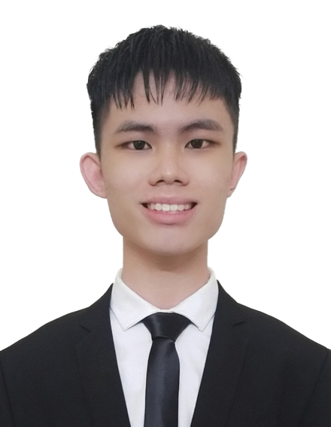
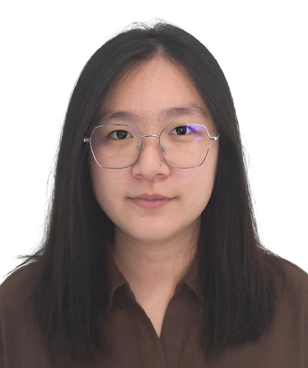

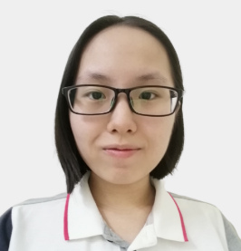
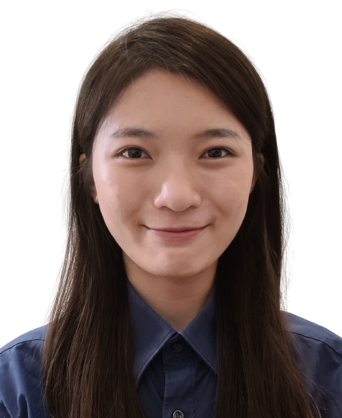
Team Introduction
REPACKAGING
FEATURE
Tan Jing Jie
CEO (Leader)
Chong Siow Yen
COO
Lai Yu Liang
CIO
Chan Jia Lin
CFO
Oluwatimilehin Ileladewa
CTO
Education
Current : Ph.D - Engineering, Robotics, UTAR.
2022 : Bachelor - Computer Science, AI, UTAR.
Experience & Awards
Champion, PayHack 2023 Hackathon
1st Runner-up. Tune Protect Hackathon 2023
3rd Runner-up , Amazon Web Service (AWS) Hackathon 2020
1st Runner-up, Huawei ICT Competition 2021
Education
2022 : Bachelor - Software Engineering, UTAR.
Experience & Awards
Microsoft Certified Azure AI fundamental, 2022.
2nd runner-up in Samsung Development Day Hackathon, Treasurer of UTAR Sustainable Development club, 2022.
Chairperson of UTAR IT society, 2022.
Education
Current : Master in Engineering (Natural Language Processing), UTAR.
2022 : Bachelor - Computer Science, UTAR.
Experience & Awards
Proposed CATCH, an innovative overspeeding detection system utilizing advanced machine learning, to enhance speed enforcement efficacy.
Education
Current : Master in EngScience (Cryptography, GPU, NN), UTAR.
2022 : Bachelor – Software Engineering, UTAR.
Experience & Awards
Research Assistant at UTAR - Innovative problem-solving & collaborative teamwork contributing to beneficial breakthroughs.
Certified LCCI level 2, 2016
Education
Current : Masters in Computer Science, Natural Language Processing, UTAR.
2022 : Bachelor - Computer Science, AI, UTAR.
Experience & Awards
Champion, Vitrox FICT Competition, 2020.
2nd runner up, FICT FYP Competition, 2020
2nd Runner up Samsung UI/UX Hackathon 2023

Slide 6
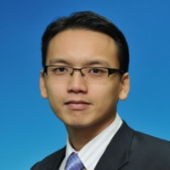
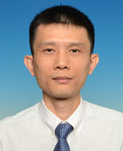
Team Introduction Our Consultant & Advisory Panel
REPACKAGING
FEATURE
Assoc. Prof Dr Shee Yu Gang
Ph.D in Communication & Network Engineering
UPM, Malaysia
Area
IT infrastructure Advisor and Legal Advisor
Experience & Achievement
Best Paper Award, VICFCNT-2021
H3C Certified Network Enginneer, 2021-2024
2nd ICMRSI Session Chair, Feb 2023
Assist. Prof Dr Kwan Ban Hoe
Ph.D in Engineering
UM, Malaysia
Area
Machine Learning Consultant
Experience & Achievement
8 years of consultation experience with diverse portfolio, including renewable energy, automation, IoT development, and electrical engineering

Slide 7

Project Introduction
REPACKAGING
FEATURE
https://coccos.jingjietan.com/

Slide 8
REPACKAGING
FEATURE

Slide 9
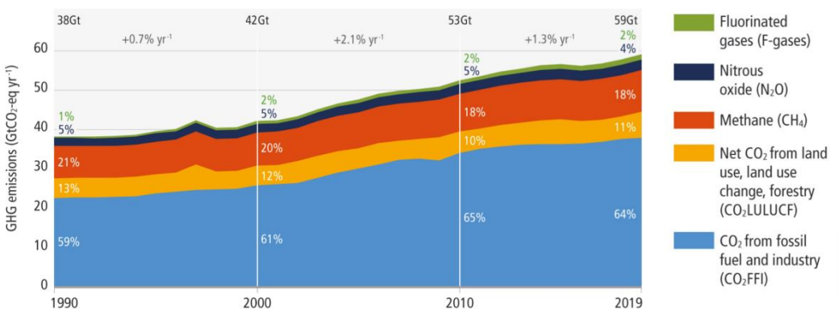
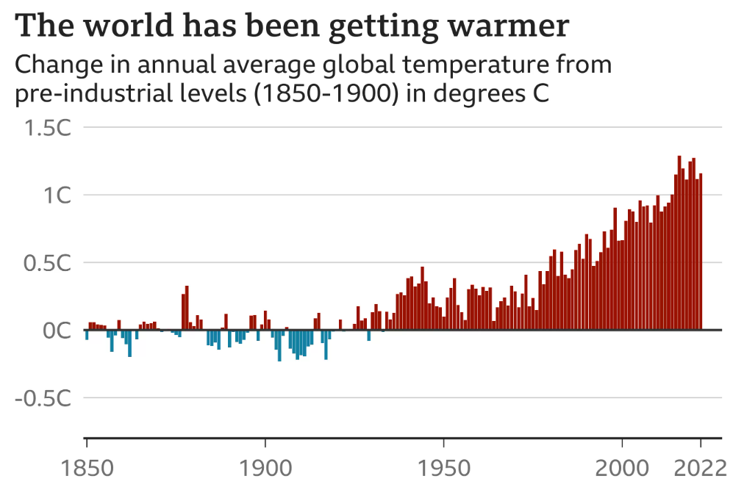
Project Introduction Immediate action needed to prevent escalating global warming
REPACKAGING
FEATURE
“
Carbon budget will be exhausted within 10 years, temperature increment of 1.5°K. Hence, mitigation of climate change is urgent and requires immediate action. [1]
”
[1] IPCC (2023) Chapter 2 — Global Warming of 1.5 oc - IPCC, Mitigation pathways compatible with 1.5°C in the context of sustainable development. Available at: https://www.ipcc.ch/sr15/chapter/chapter-2/ (Accessed: 30 July 2023).
[2] Matt.M, 2022, Global warming set to break key 1.5C limit for first time. BBC News. Available at :https://www.bbc.com/news/science-environment-65602293 (Accessed: 12 August 2023).

Slide 10
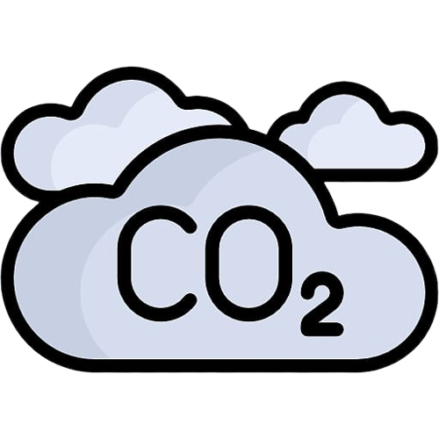

Project Introduction Action Taken: Quantifying carbon in units and trade [3]
REPACKAGING
FEATURE
User friendly unit
Using standardized units like kilograms ensures consistency and comparability of emissions data across various industries, regions, and countries. This allows for better tracking of progress in emission reduction efforts.
Regulatory Compliance
Many countries have established regulations and emissions trading schemes to limit carbon emissions. Expressing emissions in kilograms helps businesses and industries comply with these regulations and participate in emissions trading markets.
kg
Target setting
When assessing different technologies for carbon capture and reduction, expressing emissions in kilograms allows for a fair comparison of their effectiveness and efficiency in reducing CO2 emissions
[3] How to Measure my Carbon Footprint (2023). Available at: https://greenly.earth/en-us/blog/company-guide/carbon-footprint-definition-and-calculation-method (Accessed: 30 July 2023)

Slide 11
Project Introduction Carbon emission trading worldwide [11]
REPACKAGING
FEATURE
Nova Scotia
Cap-and-Trade Program
UK ETS
Austrian National ETS
German National ETS
Montenegro ETS
Switzerland ETS
EU ETS
Kazakhstan ETS
China National ETS
Chine Pilots (8 region)
Quebec Cap-and-Trade System
New york
North Carolina
Regional Greenhouse Gas Initiative (RGGI)
Sakhalin (Russia)
Ukraine
Turkey
Japan
California Cap-and-Trade Program
Oregon Climate Protection Program
Saitama ETS
Tokyo Cap-and-Trade Program
Republic of Korea ETS
Washington Cap-and-Invest
Pakistan
Mexican ETS
Nigeria
Vietnam
Pennsylvania
In force (28)
Under Development (8)
Consideration (12)
Malaysia
Colombia
Brazil
Chile
Indonesia
India
New Zealand ETS
28++ markets + commercial platforms → distinct market
[11] Emissions trading worldwide: 2023 ICAP status report (2023) International Carbon Action Partnership. Available at: https://icapcarbonaction.com/en/publications/emissions-trading-worldwide-2023-icap-status-report (Accessed: 30 July 2023).

Slide 12
Project Introduction Mechanism background for carbon credit exchange [4]
REPACKAGING
FEATURE
Mechanisms for “pricing” carbon
Voluntary Carbon Markets (VCM)
Emissions Trading System (ETS)
Carbon Tax (CT)
The European Union (EU) extensively employs the ETS.
EU's ETS covers 40% of the region's emissions.
ETS efficient in encouraging companies to invest in cleaner technologies to meet their emission allowances economically.
China is the biggest carbon credit supplier in the global VCM.
In first quarter of 2020, global VCM accounted for 20.8% of 68 million tons of Carbon-Dioxide Equivalent (MtCO₂e).
VCM projects often involve local communities, leading to positive social and economic impacts in addition to environmental benefits.
Sweden levies the highest carbon tax rate in the world.
In year 2022, Sweden has a value of €117.30 which accounted 14% of carbon tax rate.
Carbon tax can have social and economic implications as it lead to increased energy prices, encourage clean technologies, and contribute a transition to a more sustainable economy.
[4] Carbon Pricing Explained: How Carbon Credits, Carbon Offsets and Taxes are Priced (2022). Available at: https://carboncredits.com/carbon-pricing-explained-credits-offsets-taxes/ (Accessed: 30 July 2023).
Notes:
Need more to international
Show SDG
Separate to different slide, hard to see the the main point in first view
Add citation

Slide 13

Project Introduction Policy Background - International
REPACKAGING
FEATURE
In February 2022, the London Stock Exchange (LSE) announced that it would create a new market designation for funds operating in the global Voluntary Carbon Markets (VCM). The main goal is to increase the supply of quality worldwide and increase the flow of financing into projects that will directly act to reduce the carbon in our atmosphere. [5]
South Africa implemented a carbon tax in June 2019, becoming the first country in Africa to do so. The tax aimed to incentivize emission reductions and support the country's transition to a low-carbon economy. [7]
The UK has its own emissions trading system, which was established as a result of Brexit. The UK ETS is modeled after the EU ETS and covers sectors previously regulated by the EU ETS. It aims to maintain a price on carbon emissions and ensure continued emission reductions. [6]
[5] London Stock Exchange (2023). The Voluntary Carbon Market. Available at: https://www.londonstockexchange.com/raise-finance/equity/voluntary-carbon-market (Accessed: 30 July 2023).
[6] UK In A Changing Europe (2021). UK and EU Greenhouse Gas Emissions Trading Schemes. Available at: https://ukandeu.ac.uk/explainers/uk-eu-emissions-trading-schemes/ (Accessed: 30 July 2023).
[7] South Africa Carbon Pricing and Climate Mitigation Policy (2023). Available at https://www.elibrary.imf.org/configurable/content/journals$002f002$002f2023$002f195$002farticle-A003-en.xml?t:ac=journals%24002f002%24002f2023%24002f195%24002farticle-A003-en.xml (Accessed: 30 July 2023).

Slide 14

Project Introduction Policy Background - ASIA
REPACKAGING
FEATURE
China launched its national Emission Trading System (ETS) in 2020, initially covering the power sector. As the world's largest carbon market, it is expected to expand to include other industries over time. [8]
Japan was considering implementing a Carbon Tax (CT) to help achieve its climate goals. As of 2021, the government was exploring the possibility of introducing a tax on companies and industries exceeding certain emission thresholds. [10]
In Budget 2022, the Government of Malaysia (GoM) announced the implementation of a voluntary carbon market (VCM) as one of the key initiatives to address the climate change agenda. [9]
[8] China’s Emissions Trading System Will Be The World’s Biggest Climate Policy. Here’s What Comes Next (2023). Available at: https://www.forbes.com/sites/energyinnovation/2022/04/18/chinas-emissions-trading-system-will-be-the-worlds-biggest-climate-policy-heres-what-comes-next/?sh=62767f592d59 (Accessed: 30 July 2023).
[9] Malaysia’s bourse to launch voluntary carbon market by year-end (2022). Available at: https://www.reuters.com/business/malaysias-bourse-launch-voluntary-carbon-market-by-year-end-2022-08-15/ (Accessed: 30 July 2023)
[10] The Financial Impact of Carbon Taxation on Corporates: Japan (2023). Available at:
https://www.elibrary.imf.org/view/journals/018/2023/034/article-A001-en.xml (Accessed: 30 July 2023)

Slide 15
Project Introduction Market Challenges & solution for standardization and simplification
REPACKAGING
FEATURE
STANDARDIZATION
SIMPLIFICATION
SOLUTION
“
“
CarbonAPI
China's National ETS had a trading volume of 2%-3%, significantly lower than the EU-ETS which recorded a trading volume of approximately 500%. [12]
Transaction simplification is one of the market dissatisfaction. [13]
”
”
Your all-in-one solution for seamless integration across diverse carbon exchange platforms. Enjoy hassle-free regulatory compliance while receiving powerful market insights to empower your business in the carbon credit trading landscape. Simplify your carbon credit exchange journey effortlessly with CarbonAPI.
Lack of standardization across different platforms.
Different platforms complicates regulatory compliances and credit validation.
Counterparty risk
Deter investor confident for credit exchange.
Low market visibility
Inconsistency in carbon credit measures, exchange and reported, eventually hard to access the data.
Fragmented Carbon market regulation
Regulations in different market, making compliance difficult
FEATURES
Lack of transaction transparency
Introduce inconsistency and variation in trading practices, challenging to compare credit across different platforms.
Challenges in trading diverse credit carbon
Difficult to verify credit quality and authenticity in different market.
Unified marketplace
Market Intelligence and Insights
Transparent Reporting and Trading
Trade Assistance, and Regulatory Updates
Impacts exchange market activation
Limited market participation
Empowering Ecosystem: Data-Driven Sustainability Insights
[12] 中国碳市场回顾与展望(2023) (2023) 能源经济预测与展望研究报告 - Beijing Institute of Technology. Available at: https://ceep.bit.edu.cn/docs/2023-01/78387560e3084e0d8c2d5bd3e3ebff7e.pdf (Accessed: 30 July 2023).
[13] Exploring the future of the Voluntary Carbon Market (2022) Shell Global. Available at: https://www.shell.com/shellenergy/othersolutions/carbonmarketreports/shell-voluntary-carbon-market-reports.html (Accessed: 30 July 2023).

Slide 16
Project Introduction Market Challenges & solution for awareness & advocacy
REPACKAGING
FEATURE
AWARENESS & ADVOCACY
SOLUTION
“
China's National ETS had a trading volume of 2%-3%, significantly lower than the EU-ETS which recorded a trading volume of approximately 500%. [12][14]
CUX
CarbonUX
A revolutionize solution for carbon management to the public and businesses. Our application allows continuous tracking of carbon quotas, emissions, regulations, and credit exchange options. We engage in gamification and education to drive low-carbon product adoption. Moreover, businesses can utilize our service to create eco-friendly offerings, while consumers receive incentives for purchasing such products, fostering a self-sustaining ecosystem.
”
Lack awareness of global climate change / impact
Limited public awareness hinders carbon control effort.
Limited Adoption and Engagement
Hinder effectiveness of the market participation.
FEATURES
Restrict eco-solution opportunity
Miss opportunities to develop, apply and invest in technologies, practices and products that contribute to environment conservation.
Credit exchange
Promotes eco-friendly offerings
Gamification and Education
Quota, emission tracking
App Assistance, and market updates
CarbonWatch: Report & Redeem
Slow Sustainable Growth
Empowering Ecosystem: Data-Driven Sustainability Insights
[14] 中国“碳中和”政策梳理 . Available at: https://pdf.dfcfw.com/pdf/H3_AP202107231505615300_1.pdf?1627069146000.pdf (Accessed: 30 July 2023).

Slide 17

Project Introduction Growth Strategies
REPACKAGING
FEATURE
CarbonAPI
CarbonUX
Market Expansion and Insights [12, 15]
Carbon Control Coverage [12,15]
First stage: exchange platforms in the nation and expand to EU-ETS
Expand Global Reach: Collaborate with more market.
EcoMarket Insights: Provide valuable insights to governments and NGOs aligning with international carbon agreements, enhancing transparency, cooperation, and advocating for supportive policies.
First stage: transport and electricity with smart detection system
Expand Carbon Control: Extend coverage for comprehensive emission tracking, empowering eco-lifestyle practices.
AI-powered Algorithms: Machine learning for real-time data analysis, providing personalized carbon reduction recommendations to consumers.
Long term goal
Empowering Users for Environmental lmpact
Innovative Technology Integration
Enhanced User Experience: Optimize platform usability, foster engagement, and build trust through transparent governance.
Continuous Public Engagement and Awareness: Encourage community input to address environmental issues, promoting national responsibility and collective action.
Data-Driven Carbon Management: Empower government strategies with comprehensive data for sustainable carbon management.
Eco-Friendly Blockchain Implementation: Invest in sustainable blockchain integration, minimizing carbon footprint for an energy-efficient trading system. [16]
Metaverse Market Engagement: Utilize metaverse technologies to create immersive experiences, educating users and fostering a sustainable future.[17]

Slide 18
Technical Architecture
REPACKAGING
FEATURE
[15] Understanding Carbon Markets in China - KWM (2021) Kings&Wood Mallesons. Available at: https://www.kwm.com/hk/en/insights/latest-thinking/carbon-markets-in-china.html (Accessed: 30 July 2023).
[16] 区块链赋能 "碳达峰碳中和“白皮书 (2023). Available at: http://221.179.172.81/images/20220325/96861648191523266.pdf (Accessed: 30 July 2023).
[17] 元宇宙 数字孪生 碳中和 (2022). Available at: https://www.digitwin.com/newsinfo/4304108.html (Accessed: 30 July 2023).

Slide 19




… (Other 3rd party)
Technical Architecture Solution Architecture
REPACKAGING
FEATURE
CUX
CAPI
CarbonUX
CarbonAPI

Slide 20








CarbonUX
Technical Architecture
Deployment Architecture
REPACKAGING
FEATURE
The design is seperated into 2 independent portion, where:
CarbonAPI responsible in maintaining the carbon transaction record.
CarbonUX responsible in the promotion record of each user and provide insight to marketing department.
Computing
6. Update Database
3b-2. Read Database
Computing
Blockchain powered (optional)
Database
CarbonAPI
5. Forward Request
3b-1. Forward Request
CAPI
API Gateway
API Gateway
4. Submit transaction
3b. Gather related transaction
CUX
3. Retrieve and process related promotion details (if any)
2. Forward Request
2. Forward Request
1. Make transaction
1. Request analytics
API Gateway
3a. Scan the database for data analytics
API Gateway
Computing
Database
Data Analytic
** Other feature include chatbot, gamification are developed and extended under this core architecture.
The core transaction and analytic feature.

Slide 21




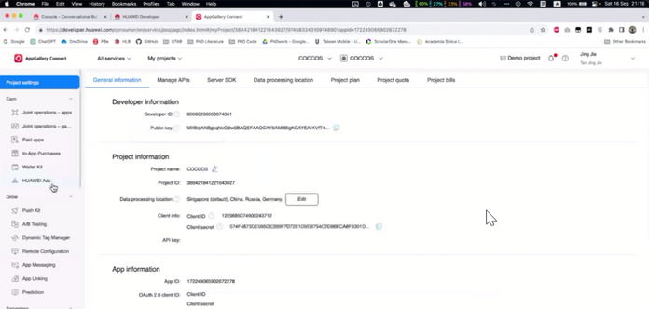
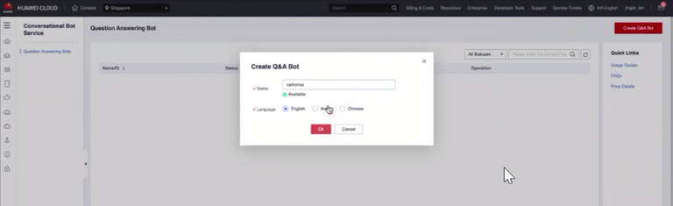
Technical Architecture
Huawei Cloud Service Dashboard
REPACKAGING
FEATURE
Chatbot
Cloud Hosting

Slide 22
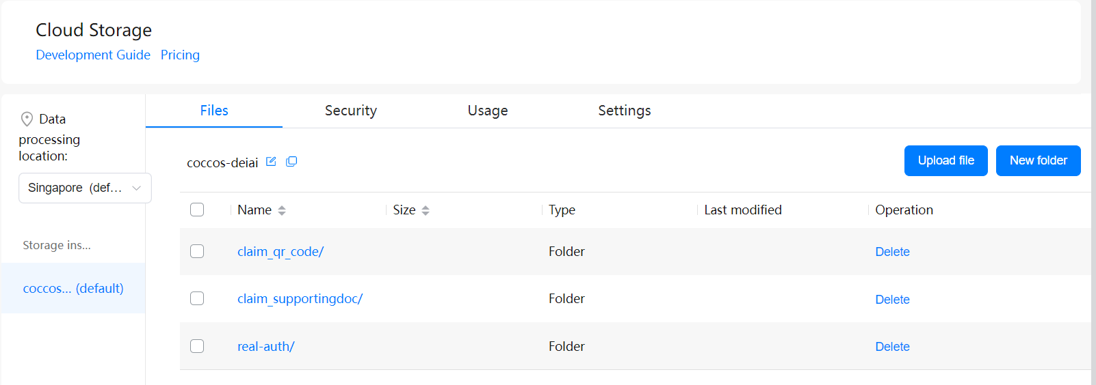
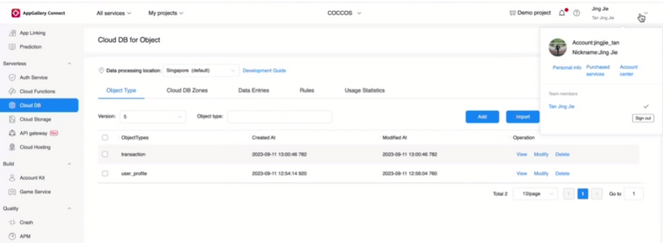
Technical Architecture
Huawei Cloud Service Dashboard
REPACKAGING
FEATURE
Cloud DB
Cloud Functions

Slide 23
Technical Architecture Technical Maturity Assessment
REPACKAGING
FEATURE
Infrastructure Scalability and Performance | Availability and Reliability | Security and Compliance | Data Management and Storage | Networking and Connectivity
Assess the cloud service's ability to scale resources up or down based on demand. | Examine the cloud provider's data centers' uptime guarantees and past performance. | Evaluate the security features provided by the cloud service, such as encryption, identity and access management, and network security. | Assess the types of storage options available, their scalability, and performance characteristics. | Evaluate the cloud provider's networking infrastructure for low latency and high throughput.
Evaluate its performance in terms of latency, response times, and throughput for various workloads. | Investigate their disaster recovery and failover mechanisms to ensure business continuity. | Check if the service complies with relevant industry standards and regulations (e.g., GDPR, HIPAA). | Evaluate data backup, replication, and restoration capabilities. | Assess the availability of features like virtual private clouds, load balancing, and content delivery networks.

Slide 24
Functions
REPACKAGING
FEATURE

Slide 25


CarbonAPI
REPACKAGING
CAPI
FEATURE
Management
Transparency
Open Integration
Opportunity
CarbonAPI is a comprehensive repository for carbon offset credits generated by projects, organizations, or individuals.
CarbonAPI enables the tracking, verification, and certification of these credits to ensure their authenticity and compliance with international standards.
CarbonAPI ensure data integrity and build trust among users, employs robust security measures to protect sensitive information and transactions.
CarbonAPI provides data transparency on carbon offset credit usage, trading trends, fostering accountability and the data- driven decision-making process.
CarbonAPI is designed with an open integration platform, which allowing third-party developers, companies, and organizations to seamlessly integrate their services and solutions into the platform.
CarbonAPI provide integration capability to promote collaboration and innovation in the field of carbon offsetting.
CarbonAPI offers a digital marketplace where carbon offset credits can be bought, sold, and traded among corporations, governments, NGOs, and even individual carbon-conscious consumers.
CarbonAPI promote startup opportunity as well as occupation opportunity. This improving the country economy.

Slide 26



How it work?
REPACKAGING
FEATURE
CAPI
Step 02
Step 04
Step 06
Report your carbon emission.
Make profit by exchange credit to company.
Receive notification of promoting item.
CUX
1
2
3
4
5
6
Step 01
Step 03
Step 05
Register & Login to CarbonUX.
Understand your quota and possible action.
Send recycle item to get rewards.

Slide 27

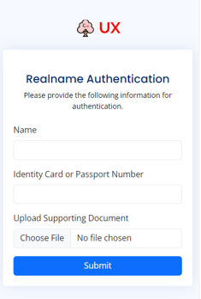
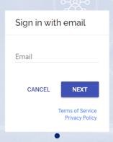
Welcome, Real Name Authentication, Create account
Functions
REPACKAGING
FEATURE
Landing page providing an introduction to the Carbon Offset Credit Centralised Optimising System
Real names and identities in promoting accountability and credibility within the carbon offset community.
WELCOME
REAL NAME AUTHENTICATE
SIGN IN

Slide 28
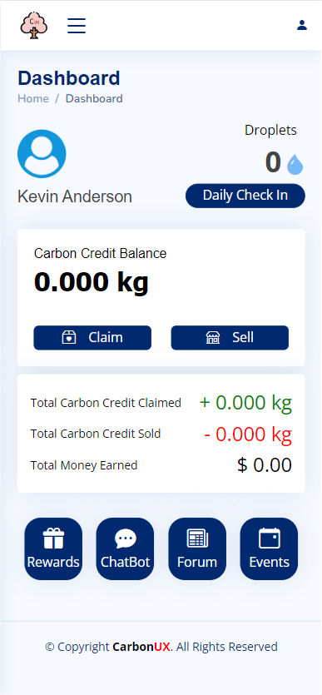
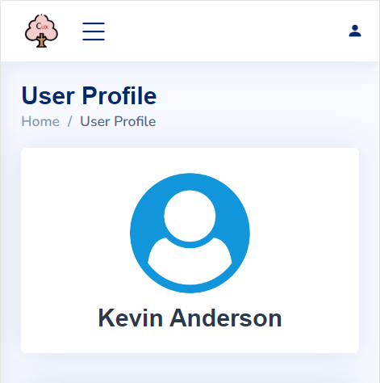
Dashboard and Profile
Functions
REPACKAGING
FEATURE
User dashboard displaying personalized information about the user's carbon offset credits, usage patterns, and recommendations for optimizing carbon offsets using ML algorithms.
User profile page allowing users to view and manage their personal information, preferences, and settings related to carbon offset credits and usage.
DASHBOARD
PROFILE

Slide 29
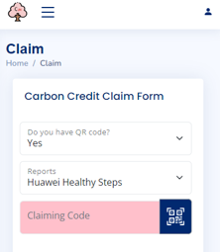
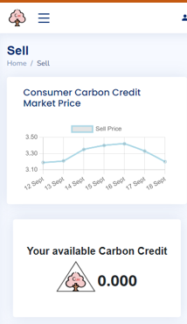
Claim, Share Carbon Offset Credits
Functions
REPACKAGING
FEATURE
Page enabling users to claim and share their carbon offset credits, encouraging others to join the initiative.
CLAIM
SHARE

Slide 30
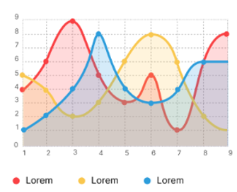
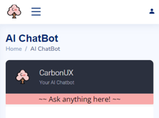
Chatbot and Statistics
Functions
REPACKAGING
FEATURE
Page explaining how ML and AI algorithms are utilized, such as Chatbot and Statistics in the system to optimize carbon offset credits and improve environmental impact.
CHATBOT
STATISTICS

Slide 31
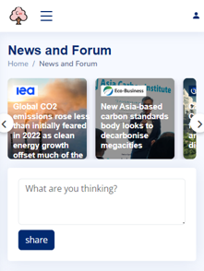
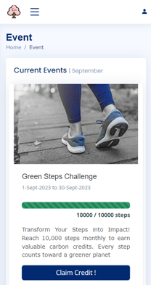
Forum/ Events (Community)
Functions
REPACKAGING
FEATURE
Forum page fostering community discussions and knowledge sharing about carbon offset practices, ML approaches, and related topics.
Page featuring upcoming events, webinars, or workshops related to carbon offsetting and ML techniques, encouraging user participation and engagement.
FORUM
EVENTS

Slide 32
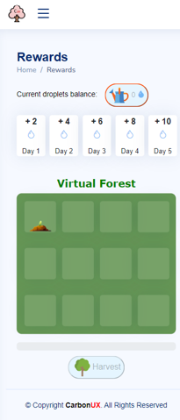
Daily Check-in/ Rewards (Incentives)
Functions
REPACKAGING
FEATURE
Page illustrating the rewards and incentives users can earn for their active participation in carbon offset activities, encouraging more engagement.
DAILY CHECK-IN
REWARDS

Slide 33
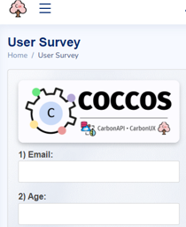
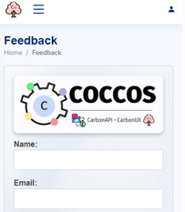
Customer Survey, Feedback
Functions
REPACKAGING
FEATURE
Survey page collecting user feedback and preferences to improve the system, enhance ML models, and tailor offerings to user needs.
Page allowing users to provide feedback on the system's usability, features, and any issues they may have encountered, aiding in continuous improvement.
CUSTOMER SURVEY
Feedback

Slide 34
Innovations
REPACKAGING
FEATURE

Slide 35
CarbonUX
Powered by CarbonAPI
CarbonUX
Powered by CarbonAPI
CUX
REPACKAGING
FEATURE
Exchange Offset Credit
Gamification and Rewards
Promote fairness when using public resources in production
Encourage user to involve in CEC with a new experience
Machine Learning
CUX
Pioneer & Adopter
Chatbot and Recommendation
First application under the CarbonAPI system
User-Friendly Interface
Education & Awareness
Adapting Large-language Model to enhance experience
Raise public awareness and promote people responsibility

Slide 36

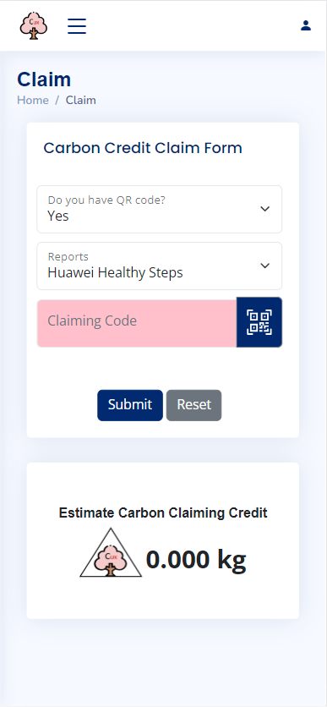
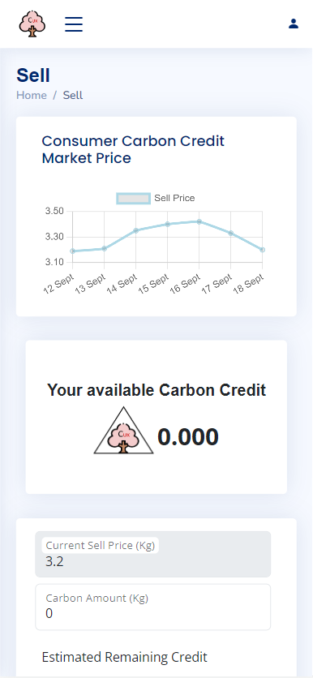
#1: Exchange Offset Credit
REPACKAGING
FEATURE
Claiming Carbon Credit
Sharing Carbon Credit
The platform facilitates the seamless claiming and sending of carbon credits. Users can easily submit their carbon offset claims by providing comprehensive reports detailing their carbon reduction activities. Users can edit their credit claims before final submission.
The system presents users with an overview of their available carbon credit balance, measured in kilograms of CO2 equivalent. Users have the option to transfer a portion of their carbon credits to other parties or entities.

Slide 37

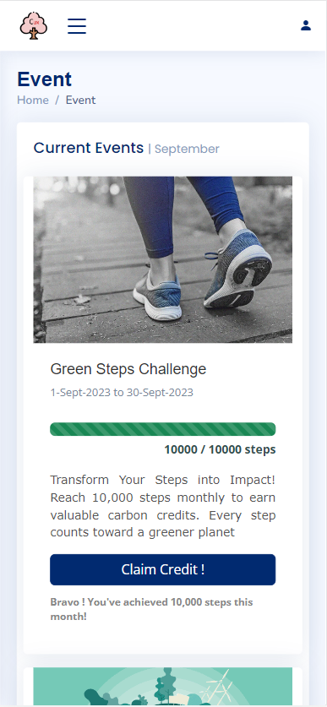
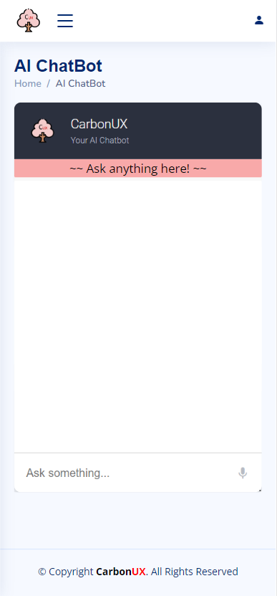
#2: Machine Learning
REPACKAGING
FEATURE
Events
ChatBot
The chatbot has the capability to present the user with all available information, provide summarized overviews of each navigation, and exhibit requested details on demand.
The events can include webinars, workshops, seminars, and conferences, all aimed at promoting education and awareness about carbon offset strategies and their impact on mitigating climate change.
done by ModelArt, MindSpore, Huawei

Slide 38

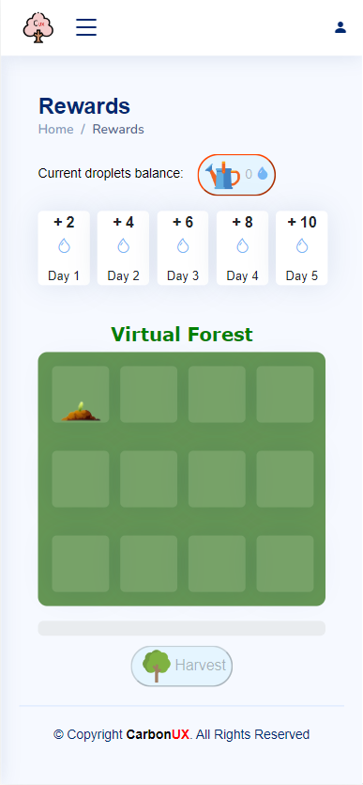
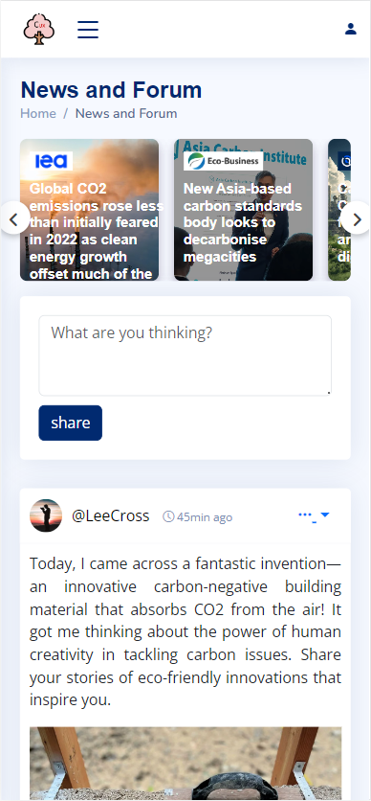
#3: Gamification and Rewards
REPACKAGING
FEATURE
Daily check-in and Gamification
Forum
The forum serves as a hub where individuals and organizations can ask questions, seek guidance, and participate in discussions about carbon credit projects.
Users engage in the daily check-in process for seven consecutive days. Each day presents a special reward.

Slide 39
COCCOS better than existing system?
REPACKAGING
PLUGINS INCLUDE:
FEATURE
AirCarbon Exchange
Carbon Trade Exchange (CTX)
AirCarbon
As a blockchain-based platform, it could be difficult for some users to comprehend cryptocurrencies and blockchain technology, and itself consume a lot electricity too.
It offers many carbon credits, but the users are not facilitated with rewards and gamification system
Require personal data for carbon footprint calculations or transactions, posing data security and privacy problems
Transparent and secure technology allows trustworthy transactions
It provides a user-friendly interface for buying and selling carbon credits globally
Empowers individuals to track their carbon footprint and offset it by supporting certified carbon offset projects
User-friendly Trading Hub for Varied Users
Integrated and Unified Platform
Facilitated application with ensuing incentives
A
B
Carbon Trading Platform in the Digital Revolution
solution include ALL aforementioned.
Notes:
YS

Slide 40
Business Value
REPACKAGING
FEATURE

Slide 41





Business Value Expected Social and Business Value
REPACKAGING
FEATURE
Community Behavioural Change
Financial Incentives
Mitigation of Climate-Related Risks
Economic Development
Public Health Benefits
Job Opportunities

Slide 42
Business Value
Business Model: Software as a Service
REPACKAGING
FEATURE
Sell carbon credits to gain income
Recycle product to redeem rewards
Carbon Emitter
Purchase carbon credits to offset emissions
Individual User
Corporate branding and social responsibility
Recycling Corporate
Software as a Service
C

Slide 43








Business Value
Business Opportunity Identification: Target market - 3rd party platform
REPACKAGING
FEATURE
CAPI
CarbonAPI

Slide 44


Business Value
Technology Selection & Compliance with Laws and Regulations
REPACKAGING
FEATURE
Adopt Verified Carbon Standard (VCS), a global carbon crediting mechanism that verifies carbon offset by issuing credits to projects that reduce or remove carbon emissions

Slide 45
Production Flow
CarbonUX
Powered by CarbonAPI
REPACKAGING
FEATURE
CAPI
CarbonAPI
Adopt Verified Carbon Standard (VCS), a global carbon crediting mechanism that verifies carbon offset
Developer Team develop a centralised application, CarbonUX (powered by CarbonAPI)
1
Developer Team design the CarbonAPI architecture
2
3

Slide 46

Business Value
Budgeting
REPACKAGING
REPACKAGING
FEATURE
Estimated Total Investment : $ 100,000
Marketing
($ 10,000)
Maintenance
($ 30,000)
Online and offline advertising to promote application
10%
30%
Customer service and technical support
20%
C
VCS Program Fee
($ 20,000)
40%
Production and R&D
($ 40,000)
Project Registration Review fee of $2500 and issuance fee of $0.20 per Verified Carbon Unit
Development of COCCOS (CarbonAPI and CarbonUX)

Slide 47
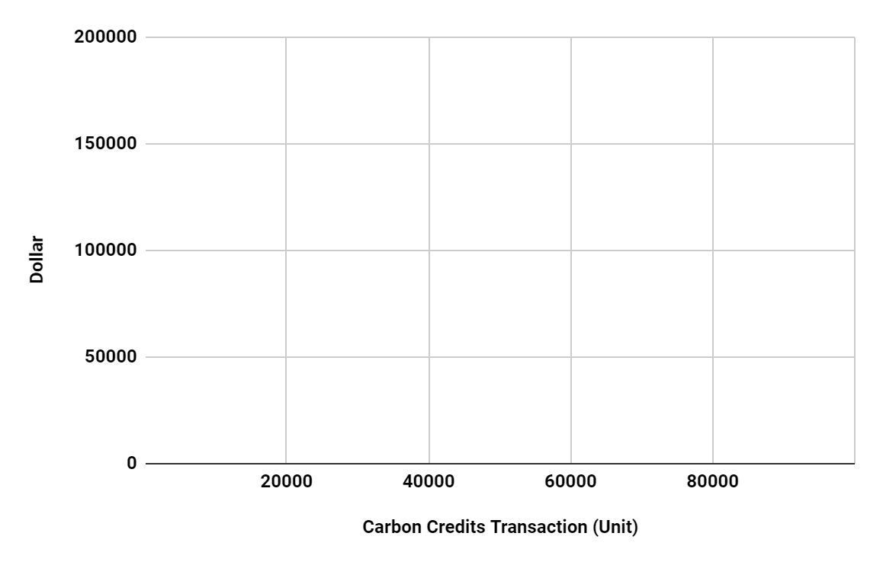

Business Value
Break-Even Analysis
REPACKAGING
FEATURE
revenue
Unit of Carbon Credit Transaction | - | 10000 | 20000 | 30000 | 40000 | 50000 | 55550 | 60000
Fixed Cost ($) | 100000 | 100000 | 100000 | 100000 | 100000 | 100000 | 100000 | 100000
Variable Cost ($) | - | 2000 | 4000 | 6000 | 8000 | 10000 | 11100 | 12000
Total Cost ($) | 100000 | 102000 | 104000 | 106000 | 108000 | 110000 | 111100 | 112000
Commission revenue ($) | - | 20000 | 40000 | 60000 | 80000 | 100000 | 111100 | 120000
Profit ($) | (100000) | (82000) | (64000) | (46000) | (28000) | (10000) | 0 | 8000
break- even point
total cost (variable + fixed)
fixed cost
Expected ROI upon 55,550 carbon credit units (kg) transaction

Slide 48





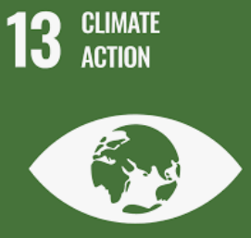



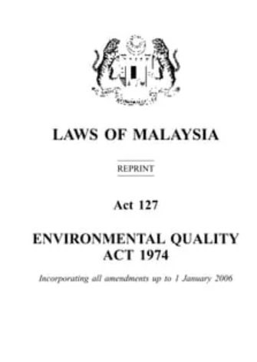

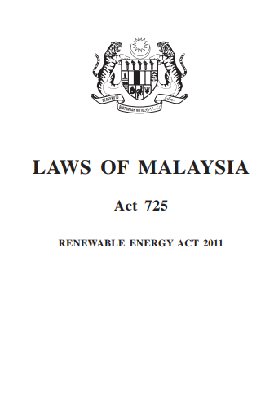
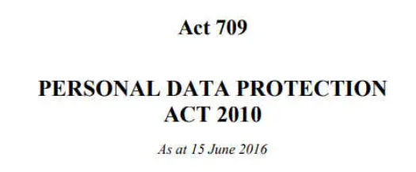
Business Value
Laws and Regulation
REPACKAGING
FEATURE
Agencies/NGOs involved
Fulfiling SDG goals:
In compliance with
Legal Review
Transparency
Privacy by Design
User Control
Data Collection and Consent
Training and Monitoring

Slide 49
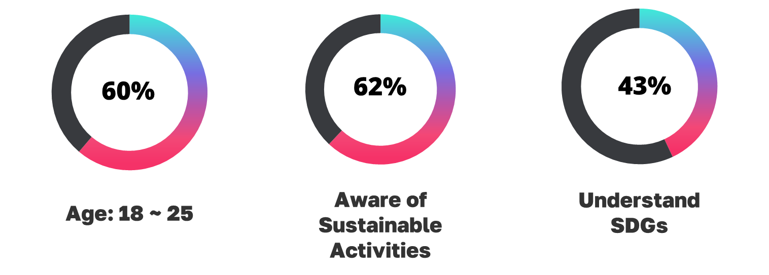
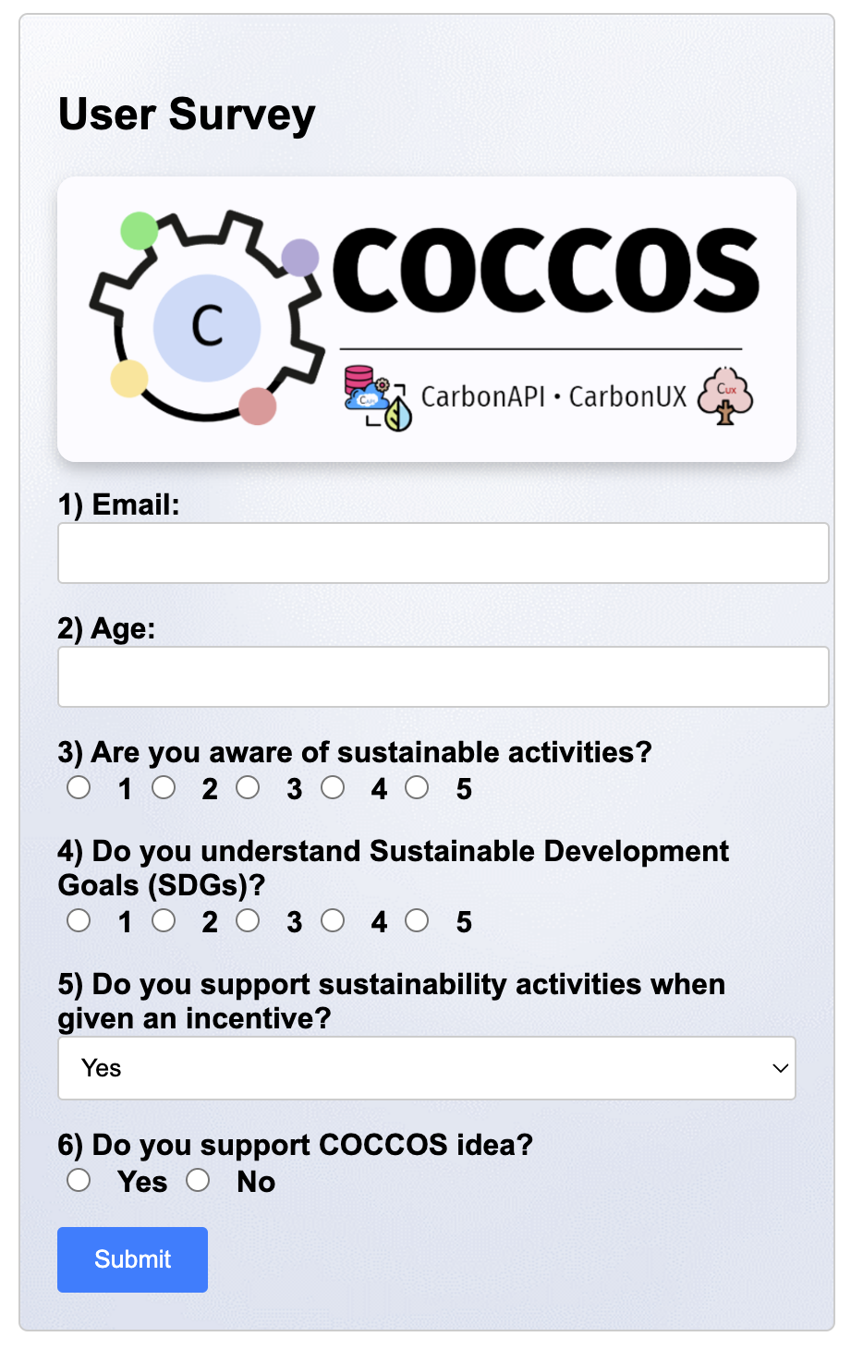
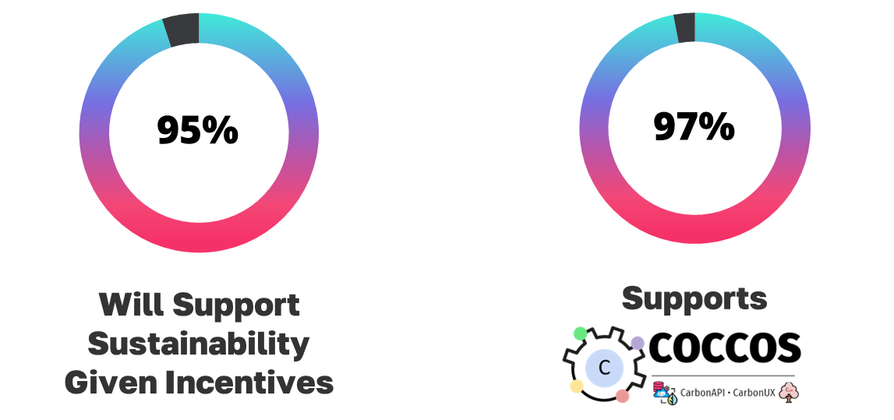
Verification [Survey]
REPACKAGING
FEATURE

Slide 50
Demonstration & Follow up plan
REPACKAGING
FEATURE
https://coccos.jingjietan.com/

Slide 51
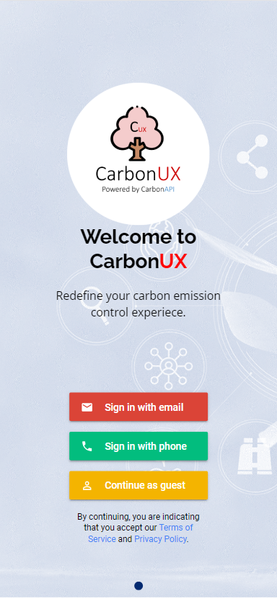
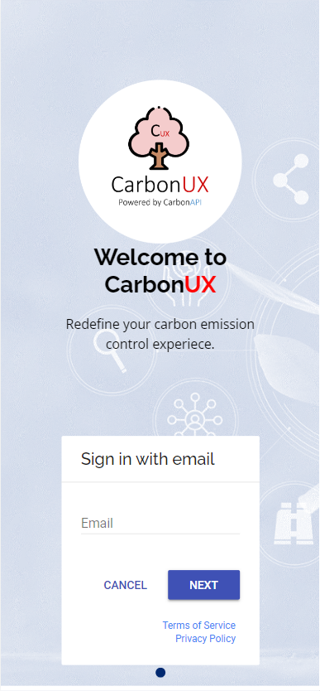
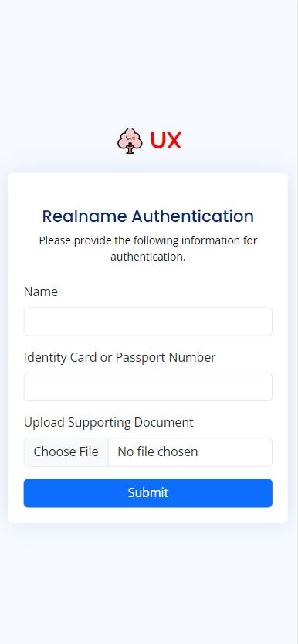
Demonstration
REPACKAGING
FEATURE
Welcome
Sign In
Real Name Authentication
Dashboard

Slide 52
Demonstration
REPACKAGING
FEATURE
Claim
Share
Event
ChatBot

Slide 53
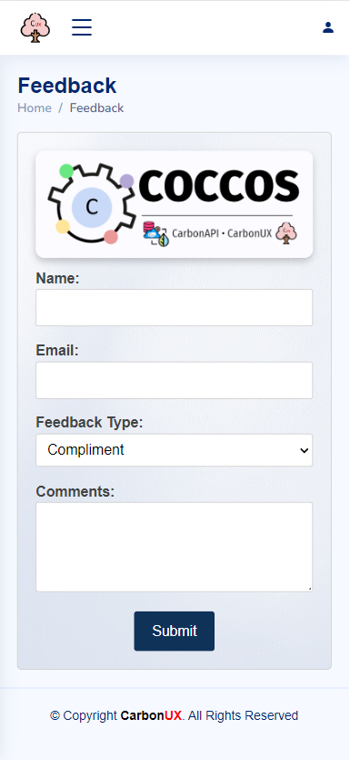
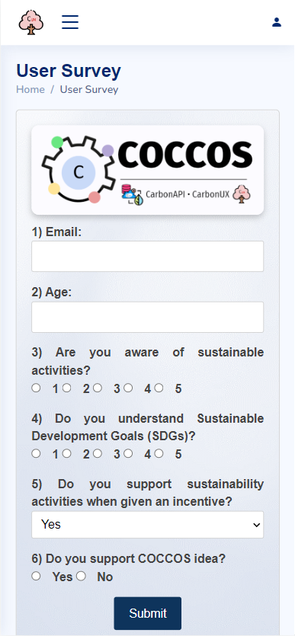
Demonstration
REPACKAGING
FEATURE
Rewards
News and Forum
Feedback
Survey

Slide 54

Demonstration
REPACKAGING
FEATURE
Assistive service
Inclusive for ALL people
[Visually Impaired can use also]

Slide 55
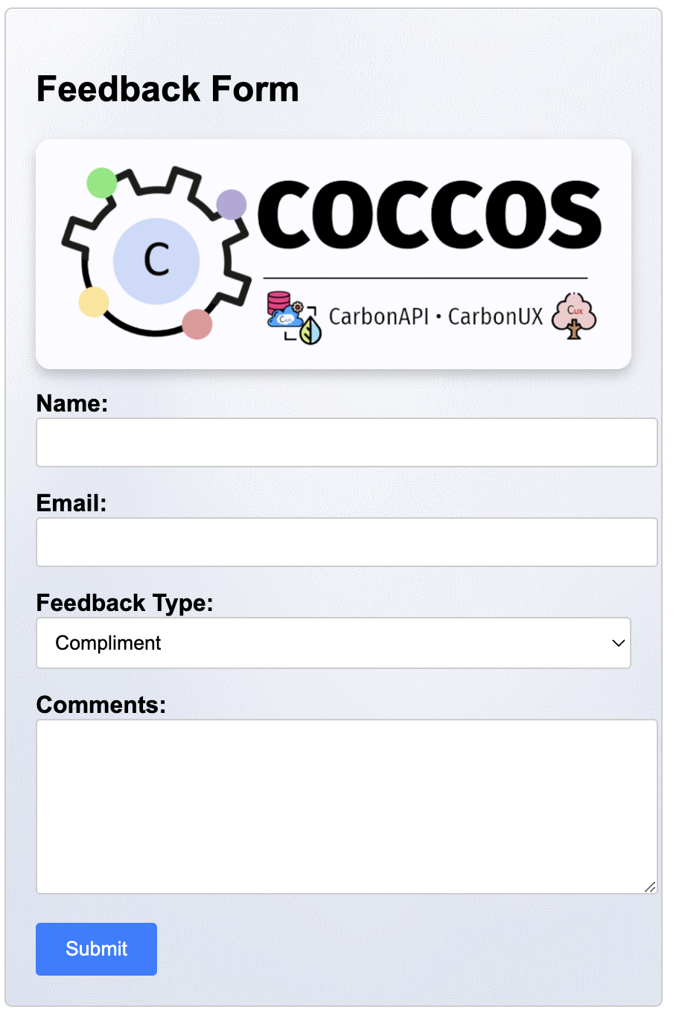

Follow up plan [Method]
REPACKAGING
FEATURE
Collect feedback via integrated feedback form
Release update after collecting feedback part by part

Slide 56
Follow up plan [Timeline and phrases]
REPACKAGING
FEATURE
Step 02
Step 04
Step 06
Rescale the architecture and feature
Approach and pitch to potential collaborator.
Optimization for next update
CUX
1
2
3
4
5
6
Step 01
Step 03
Step 05
Launch by region and make change when necessary
Get funding and full fill terms from sponsor, eg. advertisement
Get the first launch statistics

Slide 57
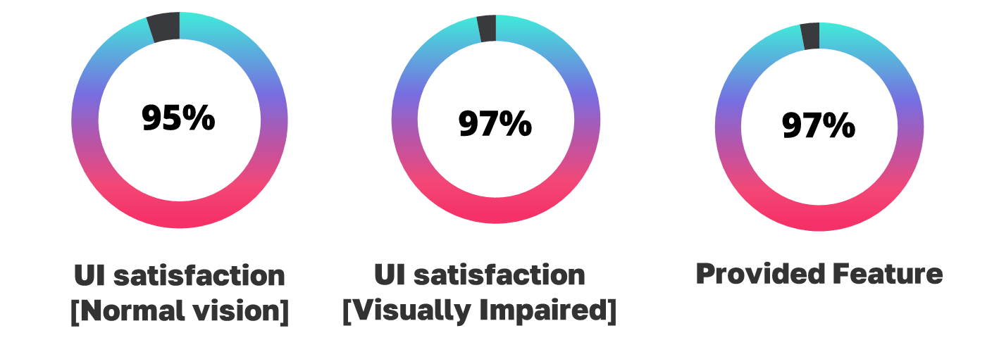
Collected feedback [Up to 16 September 2023]
REPACKAGING
FEATURE
74/78 participants
20/21 participants
96/99 participants

Slide 58









Achievements
REPACKAGING
FEATURE
← Confirmed Sponsorship and research consultancy.
Approached Potential Collaboration (GO/NGO) →
FICT

Slide 59

REPACKAGING
FEATURE
THANK YOU
Brought to you by:

